Slide 1

Sports Intermediary Application
Explore our world of sports
TEAM MEMBERS
LOGARAMAN K D - 224027084
BALAJI S - 224027031

Slide 2




ABSTRACT:
This Sports Intermediary web application is designed to serve as a seamless intermediary, connecting tournament conductors and players in the world of sports. The platform offers a straightforward and efficient solution for organizing and participating in real-time sports events.
Tournament
conductors
players
APPLICATION

Slide 3
LANGUAGES USED:
FRONT-END
- HTML
- CSS
- JAVASCRIPT
BACK-END
- Python Flask
- My SQL DataBase

Slide 4

PROBLEMS FACED BY BOTH PLAYERS AND TOURNAMENT CONDUTORS
Communication Challenges:
- For Organizers: Telling everyone about a tournament is hard. Important details can get lost, and reaching everyone is a challenge.
- For Players: Finding out about tournaments and match details is not easy.Sometimes, you might miss out on cool opportunities.

Slide 5
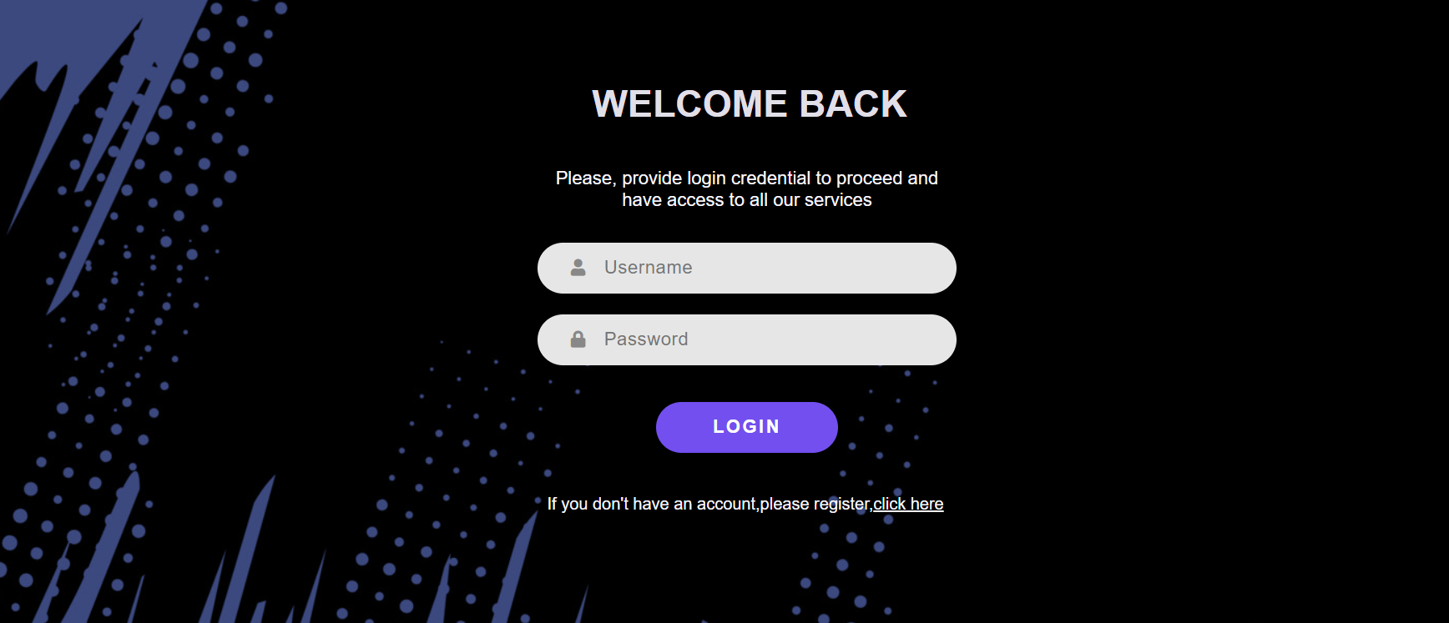
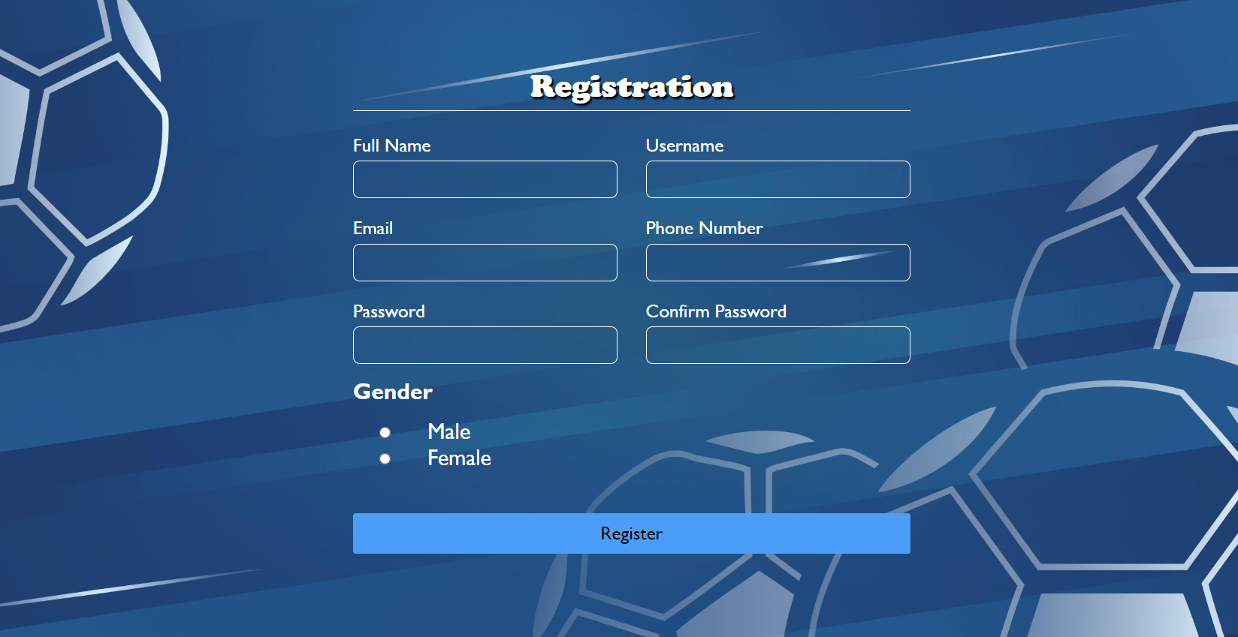
FEATURES:
User-Friendly Interface
Tournament Management
Player Registration
Match Scheduling
Results and Analytics
Login and registration

Slide 6

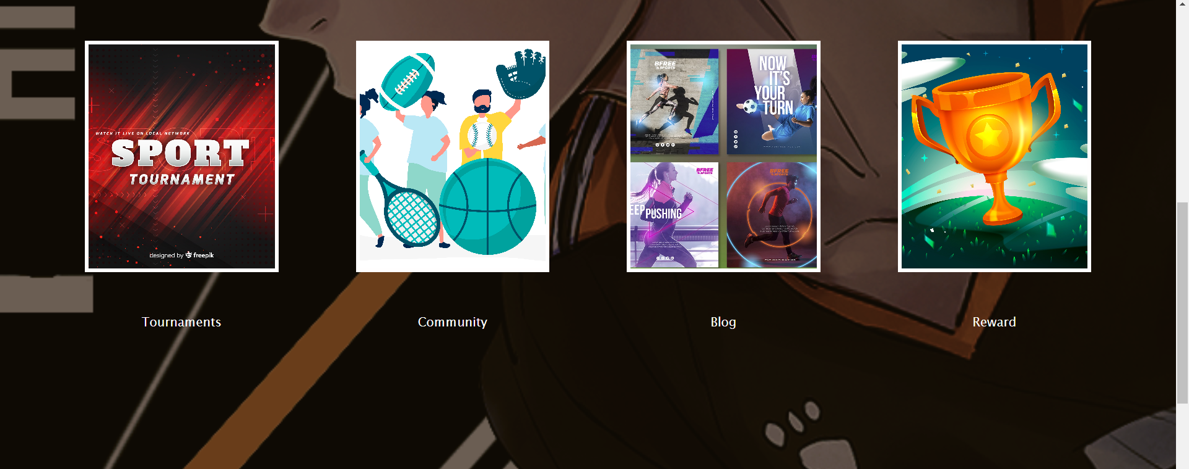
EASY NAVIGATION:
Our Landing page provides easy navigation
to the tournament conductors and Players
NOTE:This is an Abstract design
Players can participate in tournaments easily

Slide 7
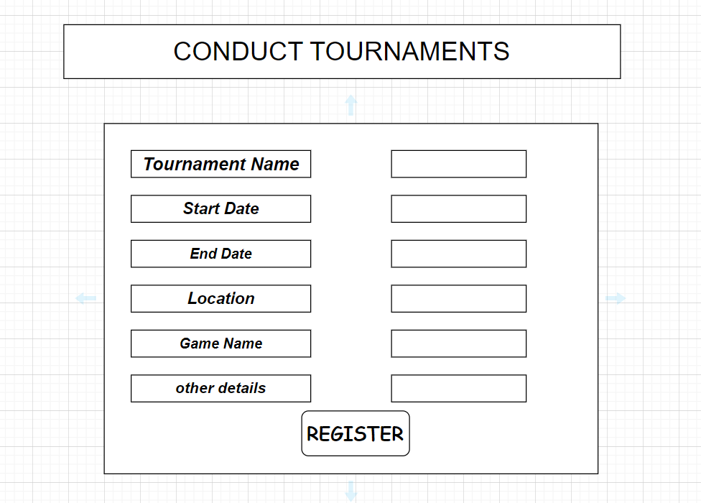
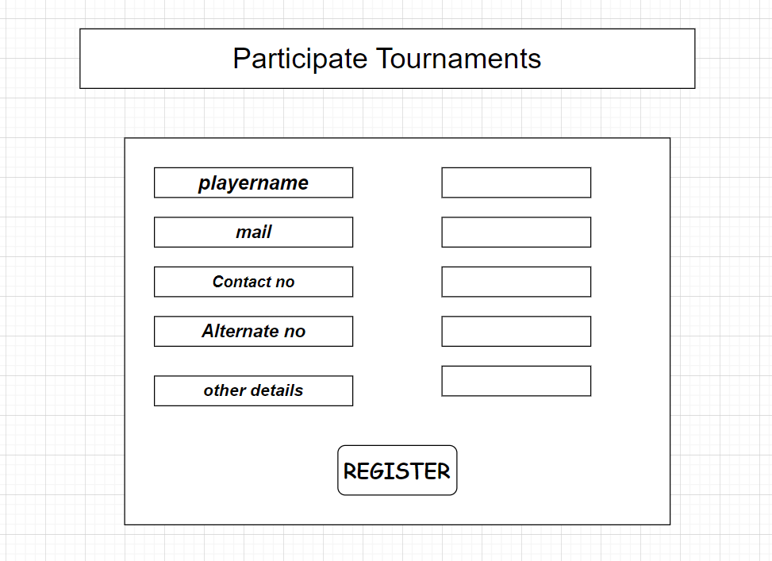
CONDUCTING AND PARTICIPATING TOURNAMENTS

Slide 8

ConnectSport
Revolutionizing Sports Community
This Application is a groundbreaking application designed for tournament conductors and players in the sports community.
This innovative platform provides a seamless and efficient way to organize and manage sports tournaments.
With this Application, tournament organizers can easily create and promote their events, while players can discover and join tournaments based on their preferences.
The application offers a range of features such as real-time updates, customizable tournament settings, secure payment integration, and a user-friendly interface.
Photo by Pexels

Slide 9

Thank You

